Slide 1
UBT
Embedded System
General Purpose IO
Astrit ADEMAJ
Prishtina

Slide 2
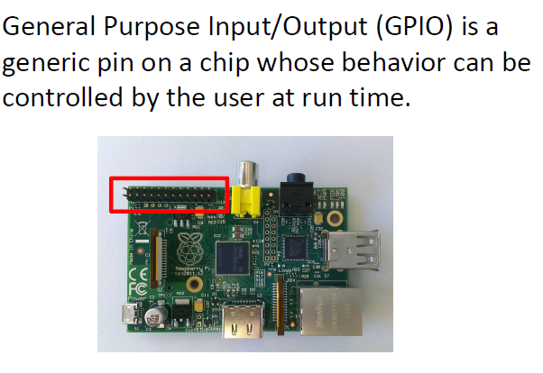
GP IO

Slide 3

GP IO
The GPIO connector has a number of different types of connection:
  True GPIO (General Purpose Input Output) pins that you can use to turn LEDs on and off etc.
  SPI interface with SPI devices
  Serial Rx and Tx pins for communication with serial peripherals

Slide 4

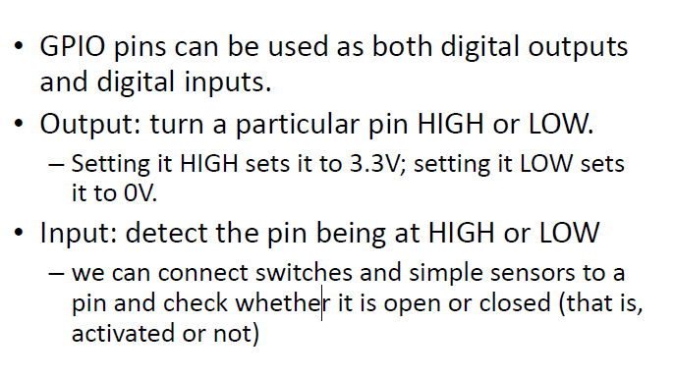
GP IO

Slide 5
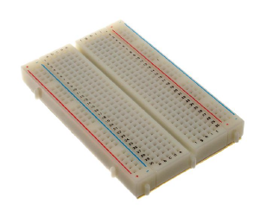
GPIO as Output
Experiment 1: Controlling LED
  LED
  Breadboard
  Jumper wire
Breadboard
  Build circuit easily without soldering

Slide 6
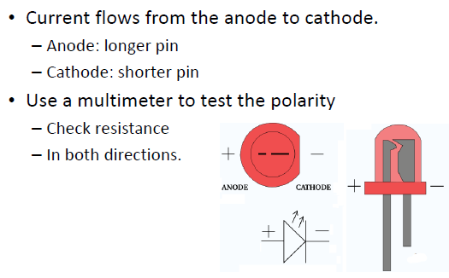
Light‐Emitting Diode (LED)

Slide 7
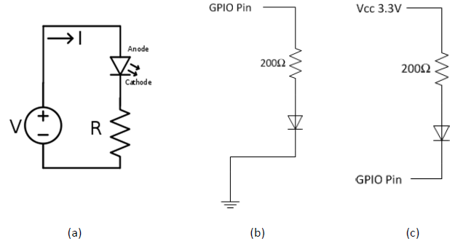
Simple LED Circuit

Slide 8
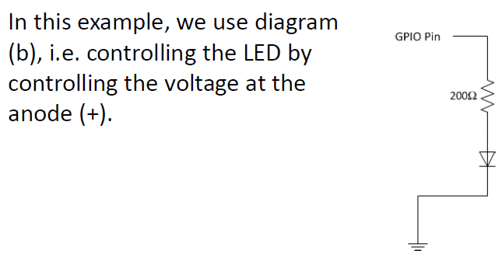
Task 1:
Turn LED on for 2 seconds and off for 1 second, loop forever

Slide 9
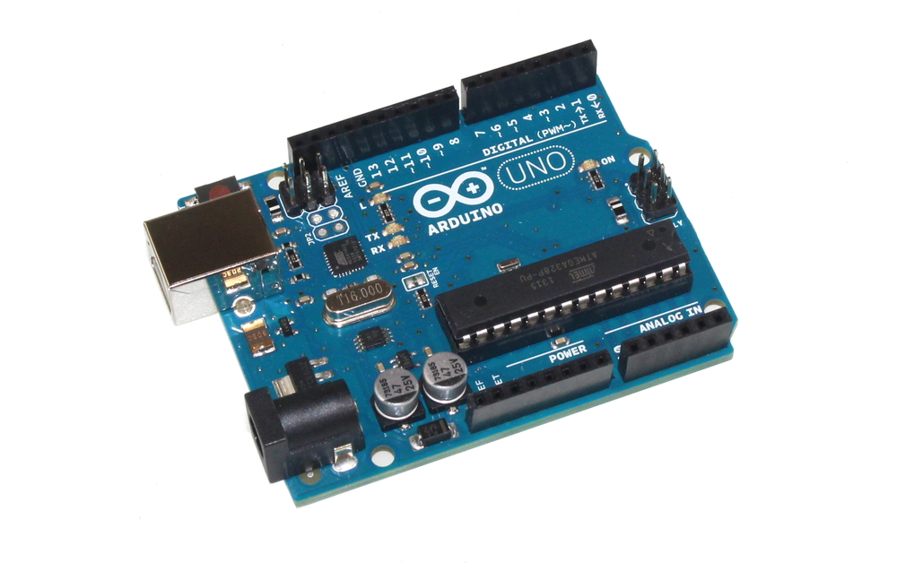
Programming board – Arduino
Equipped with Atmel-controller
ATmega328P
Which Port/Pin ?
  Refer to schematic
  Refer to MCU data sheet

Slide 10
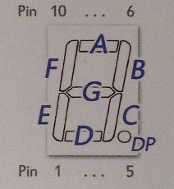
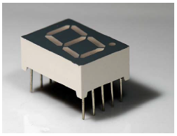
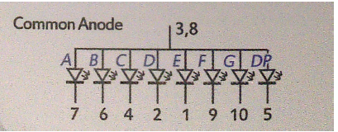
Experiment 2
Display digit on 7‐segment LED

Slide 11
Experiment 2
Most direct way to control display:
  Connect pin 3 & 8 of 7‐seg‐LED to Vcc
  Connect the other 8 pins to 8 GPIO pins
  Configure the 8 GPIO pins as output
Output LOW: turn off LED segment
Output HIGH: turn on LED segment

Slide 12
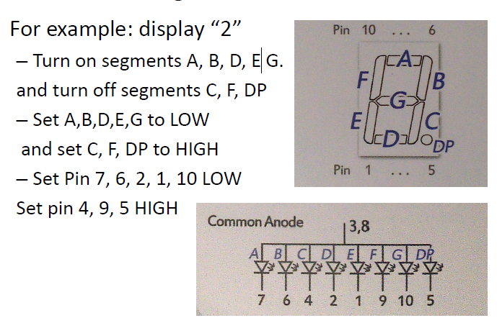
Experiment 2

Slide 13
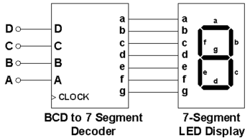

Optimizations
The most direct way uses 8 GPIO pins.
If we only display 0‐9 digits, this is inefficient.
  Use BCD to 7‐segment decoder to display digit
How to display multiple digits?

Slide 14
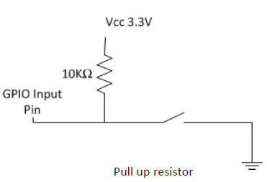
GPIO as Input
When the switch is not pushed: GPIO detects Vcc (HIGH)
When the switch is pushed: GPIO detects GND (LOW)

Slide 15
Questions?

